Slide 1
UML Diagrams
JPaint

Slide 2
Class Diagram
Paint Main
Launches the program
Does some canvas setup
Tooltips
Contains all button tooltips
Keyboard Shortcuts
Contains all the needed shortcuts for menus and buttons
Image Loader
Loads images for buttons
My Menu
Sets up the menu bar
Logger
Logs the users actions to a text file
File Menu Functions
Contains the functionality for saving and opening files
Settings Menu Functions
Contains the functionality for the settings menu
Toolbar Functions
Contains the functionality for the bottom toolbar
Tools Menu Functions
Contains the functionality for the various tools (drawing, undoing, etc)
Tab Close Popup
Opens to warn user before closing a tab
Tab Arrays
Contains canvas information for each tab
About Menu
Window containing about section
Resize Window
Window for resizing the canvas
Close App Popup
Opens to warn user before closing the program
Data Corruption Menu
Opens to warn user about data corruption when saving
Stack Canvas
Contains canvas information for a single tab
Save Timer
Contains the timer for autosaving

Slide 3
Activity Diagram
User Clicks
On Canvas?
On resize canvas?
On about menu?
On a menu?
On a menu item?
On a button?
No
No
No
No
No
No
Yes
Yes
Yes
Yes
Yes
Yes
Tool/Color Grabber on?
No
Open Resize Dialog
Open About Menu
Open Menu
Execute on click action for menu item
Execute on click action for button
Yes
Draw/Grab Color

Slide 4
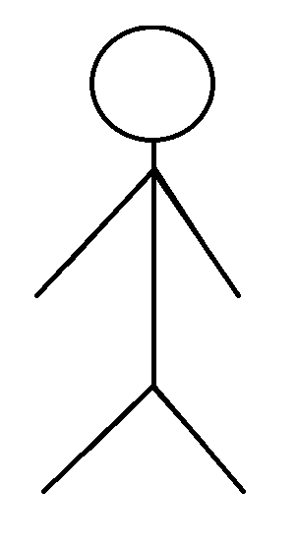
Use-Case Diagram
Undo Action
Open Image
Redo Action
File Manager
Canvas
Save Image
Rotate Image
Width Slider
User
Tab Manager
Open/Close Tabs
Draw
Drawing Tools

Slide 5
State Diagram
Open Menu
Click on Menu
Idle
User Click
Click on Button/Menu Item
Perform Button/Menu Action
Click on Canvas
Check if tool is active
Drawing Tool Not Active
Drawing Tool Active
Draw with selected tool
Release Mouse Button

